Slide 1
Topics to Cover
Block Cipher Design Principles
Feistel Structure
DES
AES
Operating Modes of Block Ciphers

Slide 2
BLOCK CIPHER DESIGN PRINCIPLES

Slide 3
Principles of designing a Block Cipher
Confusion
Diffusion
Avalanche Effect
Feistel Structure
Round Functions
Key Size and Block Size
Bit Independence Criterion (BIC)
Key Schedule Algorithm

Slide 4
Basic Principles
Concept | Purpose | How to Achieve
Confusion | Makes the key–ciphertext relationship complex | Substitution (S-boxes)
Diffusion | Spreads plaintext influence across ciphertext | Permutation and mixing
Avalanche Effect | 1-bit input change alters ~50% of output bits | Repeated confusion & diffusion

Slide 5
S-Boxes
Uses Non-Linear Transformation to generate Outputs from Inputs.
Mapping between inputs and corresponding outputs are defined by a table or a matrix.
It should be such that its not easily invertible by an attacker.
Two main categories of S-Boxes:- Static S-Box and Dynamic S-Box

Slide 6
P-Boxes
The primary goal is to increase diffusion for a cipher, by permuting the input bits.
Permutation of the bits makes the cryptanalysis more challenging.
Types of P-Boxes: Straight P-Box, Compression P-Box, and Expansion P-Box.

Slide 7
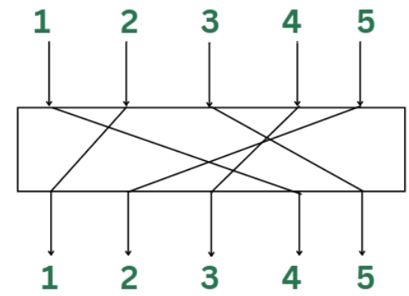
Straight P-Box

Slide 8
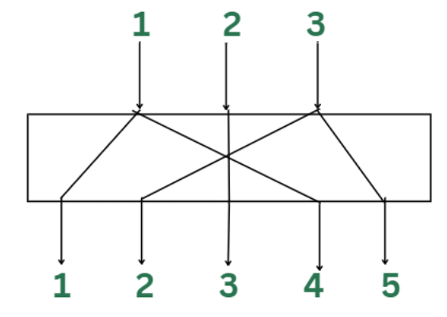
Expansion P-Box

Slide 9
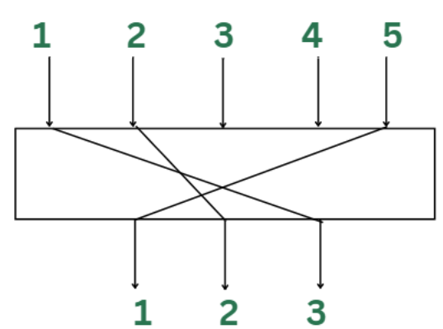
Compression P-Box

Slide 10
FEISTEL STRUCTURE

Slide 11
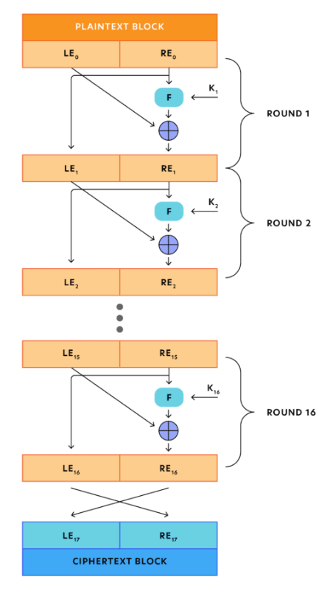
Encryption

Slide 12
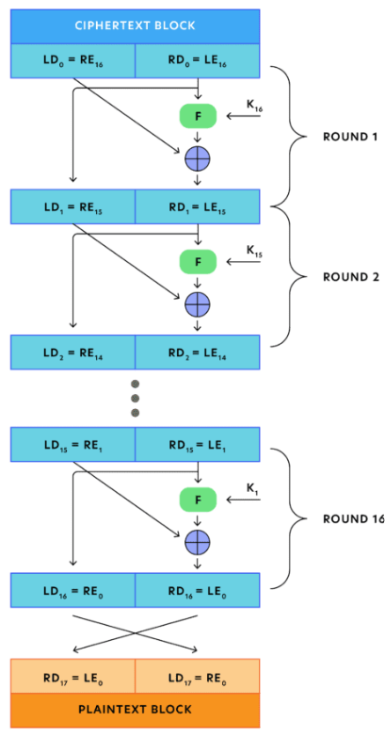
Decryption

Slide 13
Observations in Encryption and Decryption
Assume that n is the number of rounds.
During Encryption, LE_{i} = RE_{i-1}
During Encryption, RE_{i} = LE_{i-1} ⊕ F(RE_{i-1}, K_{i})
During Decryption, LD_{i} = RD_{i-1}
During Decryption, RD_{i} = LD_{i-1} ⊕ F(RD_{i-1}, K_{n-i+1})
LD_{i} = RE_{n-i}
RD_{i} = LE_{n-i}

Slide 14
DES

Slide 15
Key Points
Developed by IBM.
Adopted as a federal standard by NIST in 1977.
Input = 64-bit block
Output = 64-bit block
Original Key Length = 64 bits
Effective Key Length = 56 bits
Round Key = 48 bits
Consists of 16 rounds.
Each Round consists of different operations like Substitution, Permutation, Key-Mixing, and Expansion.

Slide 16
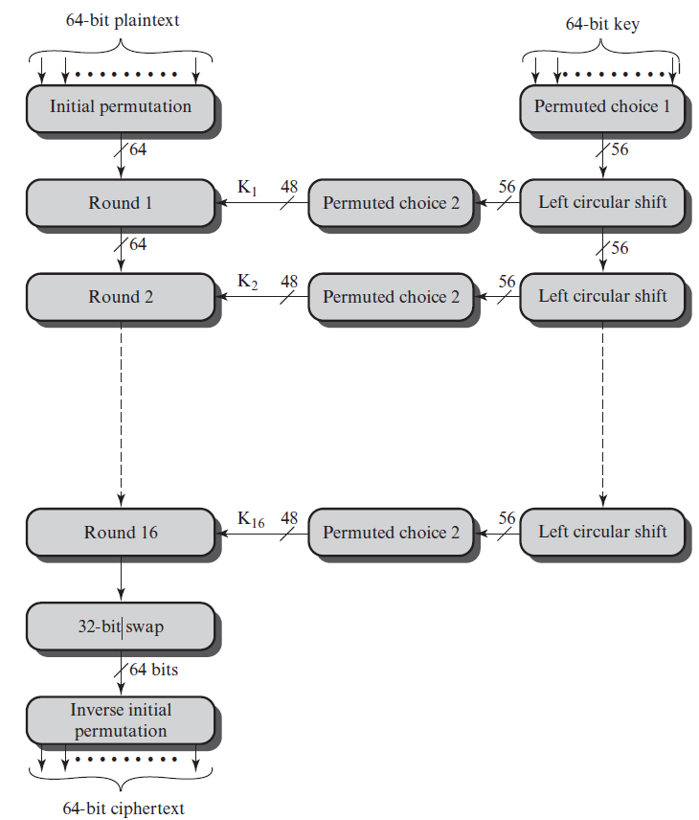
DES Encryption

Slide 17
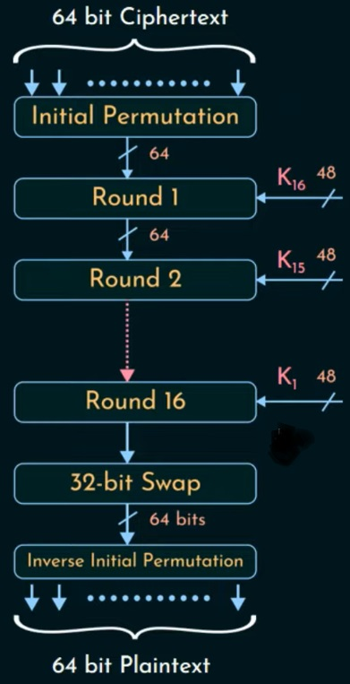
DES Decryption

Slide 18
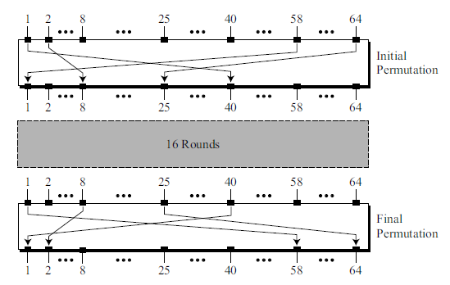
Initial and Final Permutations

Slide 19
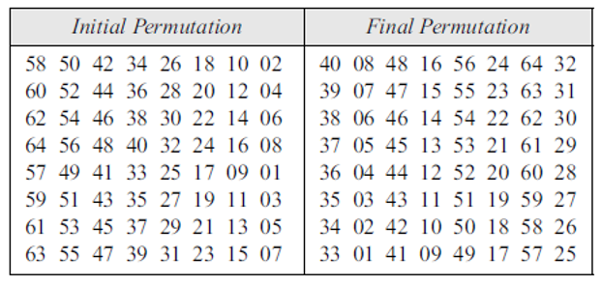
Initial and Final Permutations (Contd..)

Slide 20
Numerical 1
Compute the outputs of the IP for the below Plaintexts:-
0x0000 0000 0000 0080
0x0002 0000 0000 0081
0x0002 0000 0000 00C1
Solution:-
0x0000 0000 8000 0000
0x0000 0080 8000 0002
0x8000 0080 8000 0002

Slide 21
Numerical 2
Compute the ciphertexts for the below inputs to IP⁻¹ :-
0x0000 0000 8000 0000
0x0000 0080 8000 0002
0x8000 0080 8000 0002
Solution:-
0x0000 0000 0000 0080
0x0002 0000 0000 0081
0x0002 0000 0000 00C1

Slide 22
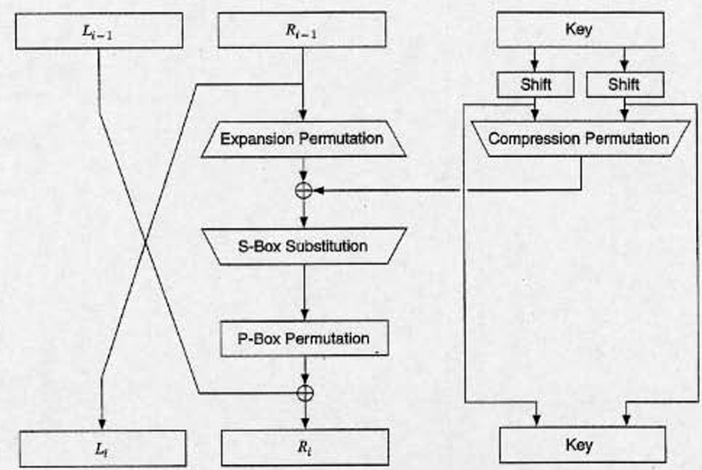
One Round of DES

Slide 23
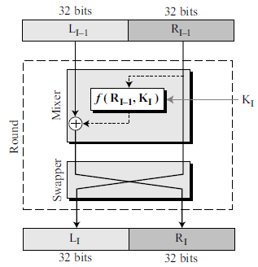
One Round of DES (Contd..)

Slide 24
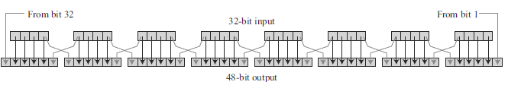
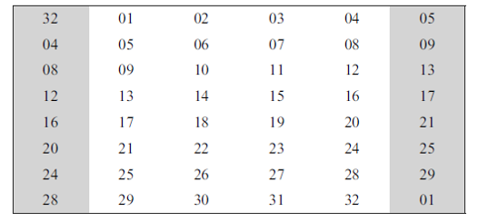
Expansion P Box

Slide 25
Numerical 3
Compute the outputs of the Expansion P box for the below inputs which are fed to a certain round:-
0x00000081
0x00000018
Solution:-
0x800000001402
0x0000000000F0

Slide 26
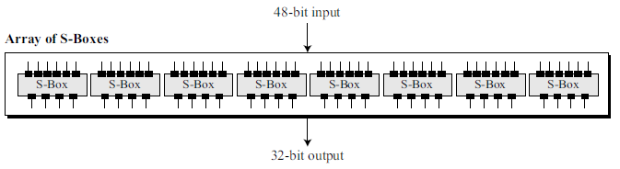
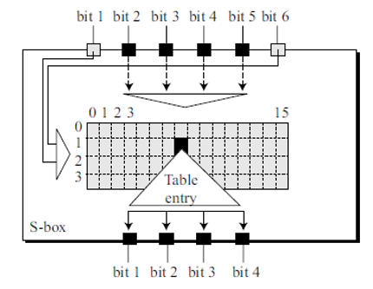
S-Boxes

Slide 27
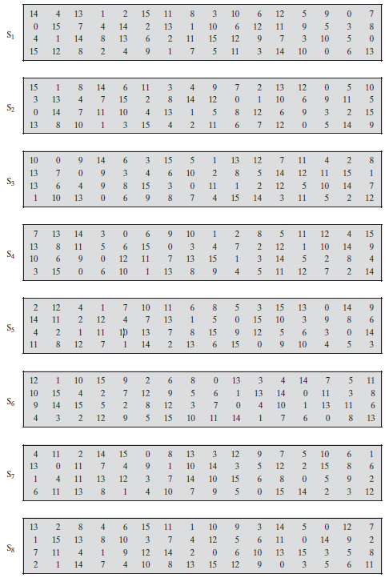
S-Boxes (Contd..)

Slide 28
Numerical 4
Compute the output of the 48-bit input 000100 100011 010001 010110 011110 001001 101010 111100 which is fed to the S-Box stage of a certain round
Therefore, the output is 1101 1000 0010 0101 1001 0111 0011 0101
Solution:-
S Box 1 o/p:- 1101
S Box 2 o/p:- 1000
S Box 3 o/p:- 0010
S Box 4 o/p:- 0101
S Box 5 o/p:- 1001
S Box 6 o/p:- 0111
S Box 7 o/p:- 0011
S Box 8 o/p:- 0101

Slide 29
Numerical 5
Compute the output of the 48-bit input 000011 110000 111100 001111 000011 110000 111100 001111 which is fed to the S-Box stage of a certain round
Therefore, the output is 1111 0101 1110 0011 1011 0111 1001 0100
Solution:-
S Box 1 o/p:- 1111
S Box 2 o/p:- 0101
S Box 3 o/p:- 1110
S Box 4 o/p:- 0011
S Box 5 o/p:- 1011
S Box 6 o/p:- 0111
S Box 7 o/p:- 1001
S Box 8 o/p:- 0100

Slide 30
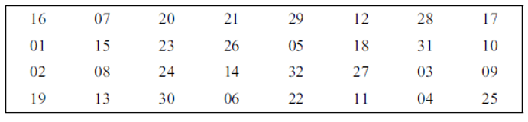
Straight Permutation

Slide 31
Numerical 6
Compute the outputs of the below 32-bit inputs which are fed to the straight permutation of a certain round:-
0x02011000
0x02011008
Solution:-
0xE0000000
0xE8000000

Slide 32
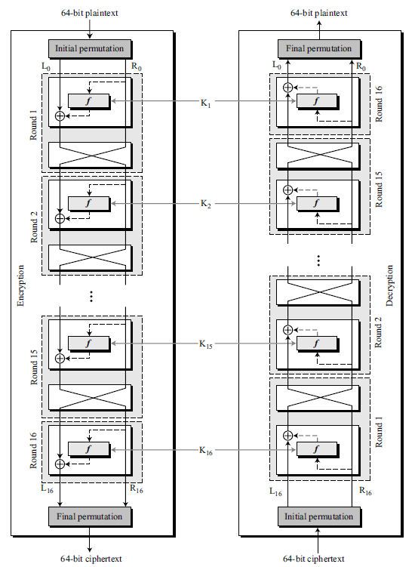
Cipher and Reverse Cipher

Slide 33
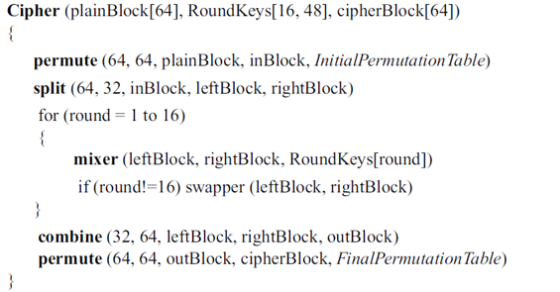
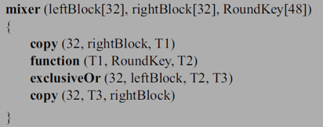
DES Cipher Pseudocodes

Slide 34
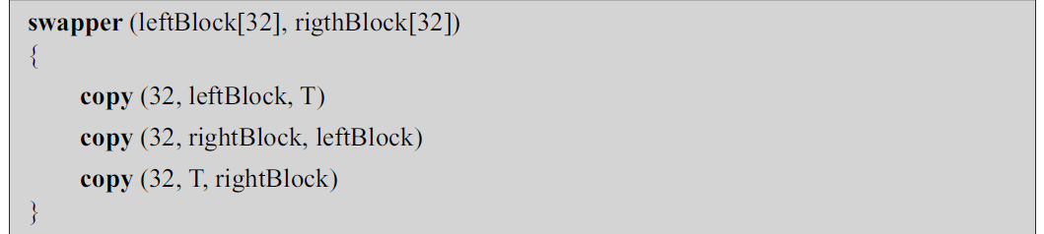
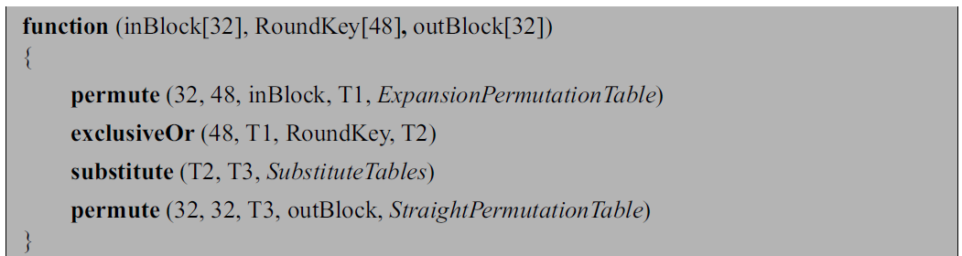
DES Cipher Pseudocodes (Contd..)

Slide 35
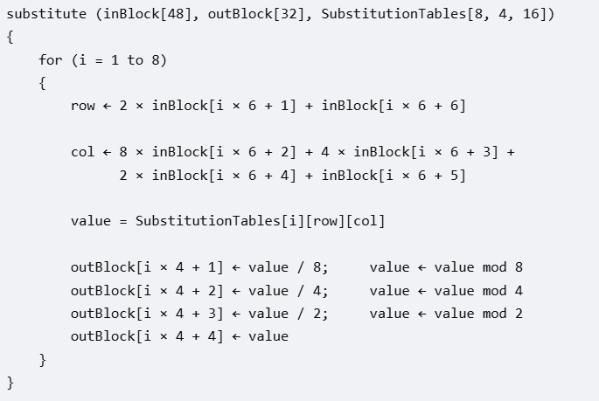
DES Cipher Pseudocodes (Contd..)

Slide 36
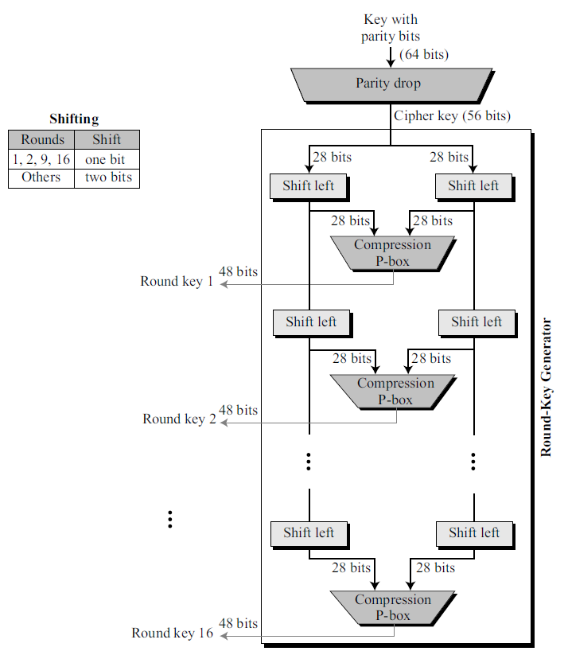
DES Key Generation

Slide 37
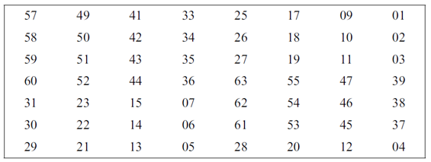
DES Key Generation Parity Drop

Slide 38
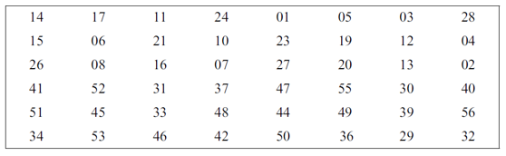
Compression Permutation

Slide 39
Numerical 7
Compute the round keys for the first 3 rounds, when a 64-bit key 0x0000 0000 0000 0080 is fed as input
Solution:-
Parity Drop Phase:-
Effective Key = 0b 1000 0000 0000 0000 0000 0000 0000 0000 0000 0000 0000 0000 0000 0000
Round 1:-
LHi:- 0b 1000 0000 0000 0000 0000 0000 0000
RHi:- 0b 0000 0000 0000 0000 0000 0000 0000
LHo:- 0b 0000 0000 0000 0000 0000 0000 0001
RHo:- 0b 0000 0000 0000 0000 0000 0000 0000
Input to compression P-box = 0b 0000 0000 0000 0000 0000 0000 0001 0000 0000 0000 0000 0000 0000 0000
o/p = 0x010000000000

Slide 40
Numerical 7 (Contd..)
Round 2:-
LHi:- 0b 0000 0000 0000 0000 0000 0000 0001
RHi:- 0b 0000 0000 0000 0000 0000 0000 0000
LHo:- 0b 0000 0000 0000 0000 0000 0000 0010
RHo:- 0b 0000 0000 0000 0000 0000 0000 0000
Input to compression P-box = 0b 0000 0000 0000 0000 0000 0000 0010 0000 0000 0000 0000 0000 0000 0000
o/p = 0x000008000000

Slide 41
Numerical 7 (Contd..)
Round 3:-
LHi:- 0b 0000 0000 0000 0000 0000 0000 0010
RHi:- 0b 0000 0000 0000 0000 0000 0000 0000
LHo:- 0b 0000 0000 0000 0000 0000 0000 1000
RHo:- 0b 0000 0000 0000 0000 0000 0000 0000
Input to compression P-box = 0b 0000 0000 0000 0000 0000 0000 1000 0000 0000 0000 0000 0000 0000 0000
o/p = 0x000000000000

Slide 42
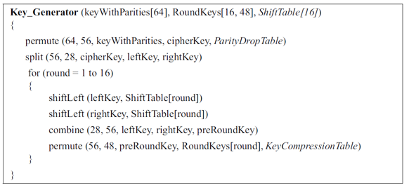
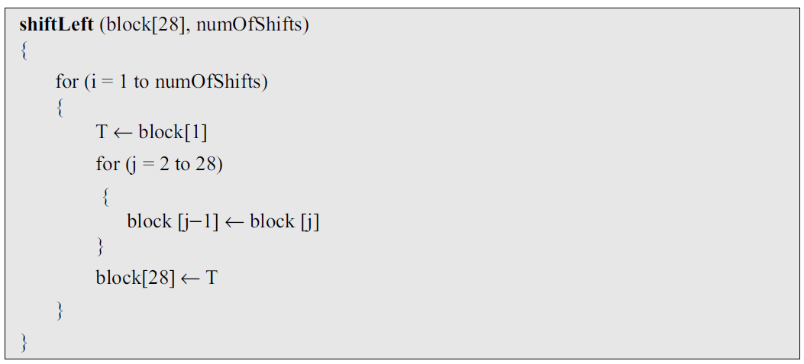
Pseudocodes for DES Round Keys Generation

Slide 43
DES Analysis
Property | Meaning | In DES
Avalanche Effect | A small change in plaintext/key causes a significant change in ciphertext | Strong; ideally, a 1-bit change affects many output bits
Completeness | Each ciphertext bit should depend on many/all plaintext bits | Achieved progressively through multiple DES rounds

Slide 44
Strength of DES
Number of possible keys = 7.2057 * 10¹⁶.
Maximum time required for a PC to execute a successful DES decryption at 10⁹ decryptions/second = (7.2057 *10¹⁶)/(10⁹/second) = 7.2057*10⁷ seconds ≈ 2 years and 3 months.
Cryptanalysis is possible by exploiting the characteristics of DES.
DES is moderately resistant to a successful timing attack.

Slide 45
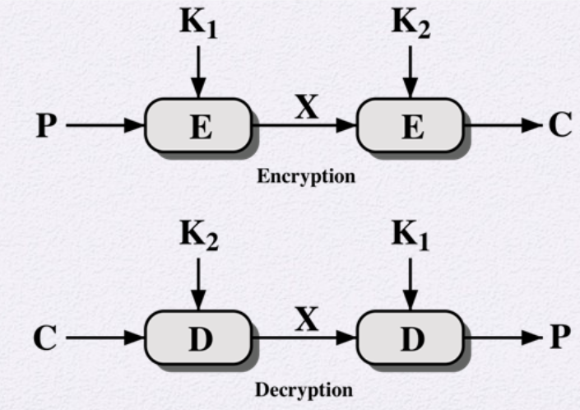
Double DES
C = E(K₂,E(K₁, P))
P = D(K₁,D(K₂, C))
Key Space = 2¹¹²

Slide 46
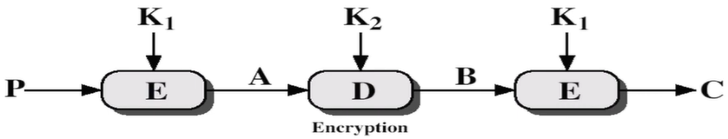
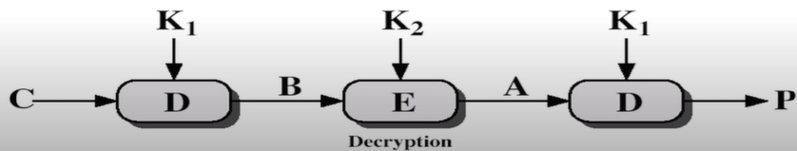
Triple DES with 2 Keys

Slide 47
Triple DES with 2 Keys (Contd..)
Double DES used the encryption functions in sequence.
Triple DES follows E-D-E sequence.
C = E(K₁,D(K₂, E(K₁,P)))
P = D(K₁, E(K₂, D(K₁, C)))

Slide 48
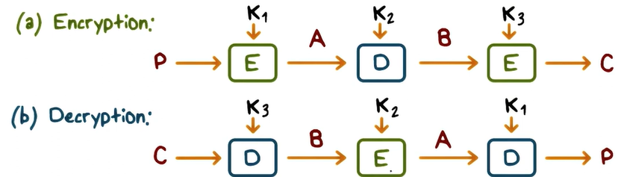
Triple DES with 3 Keys

Slide 49
Triple DES with 3 Keys (Contd..)
C = E(K₃, D(K₂, E(K₁)))
P = D(K₁, E(K₂, D(K₃)))
If K₁ = K₃ (same as Triple DES with 2 keys)
If K₁ = K₂ = K₃ (same as DES)
If K₁, K₂, and K₃ are different then highest level of security is offered.

Slide 50
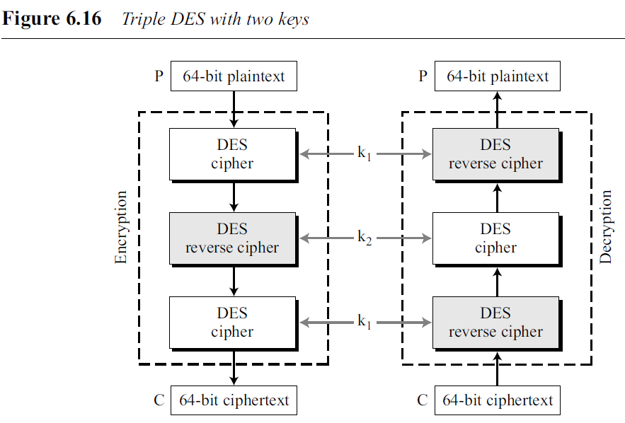
Triple DES with Two Keys
In triple DES with two keys, there are only two keys: k1 and k2.
The first and the third stages use k1; the second stage uses k2.
.

